Slide 1
Instructions for running global and local alignment
Matthew Chan’s code
PP1
chan250@purdue.edu

Slide 2
Obtain DNA and protein sequences from NCBI
Just used mouse hemoglobin in this example
I have included these fasta files in the submission
Protein: https://www.ncbi.nlm.nih.gov/protein/145301578
DNA: https://www.ncbi.nlm.nih.gov/nuccore/NM_008218.2

Slide 3
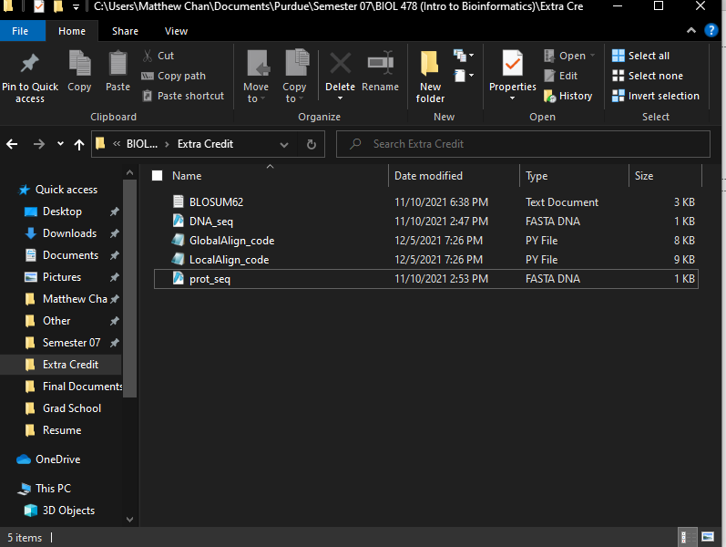
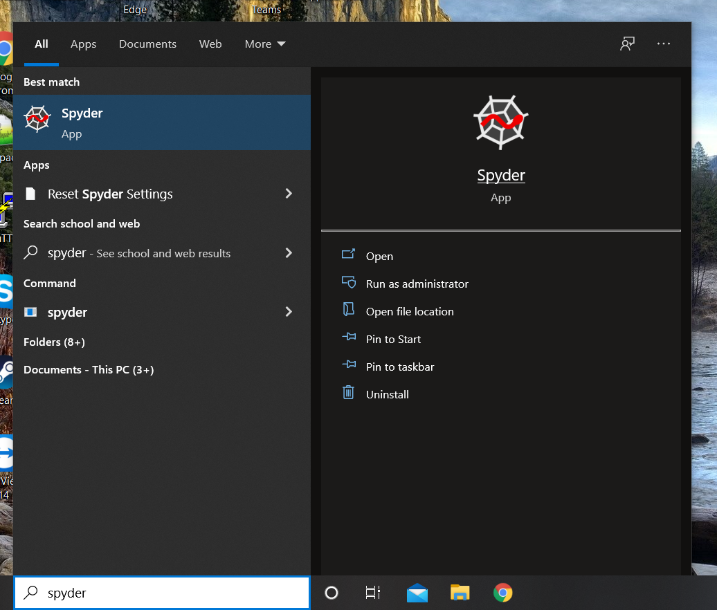
Need something to run Python, I use Spyder
Need following files
BLOSUM62
GlobalAlign_code
LocalAlign_code
DNA sequence (will be translated and has to be named DNA_seq)
Protein sequence being compared (has to be named prot_seq)

Slide 4
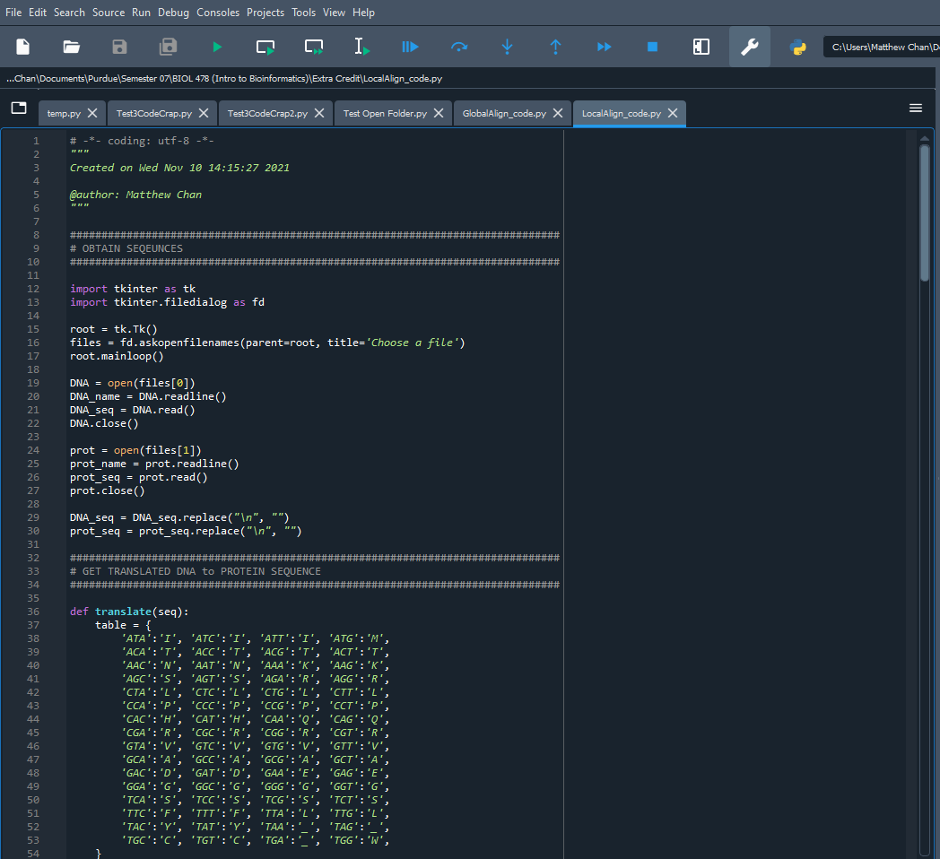
Run code by clicking green play button
Code for global and local alignment are essentially run the same so I’ll only show the local alignment

Slide 5

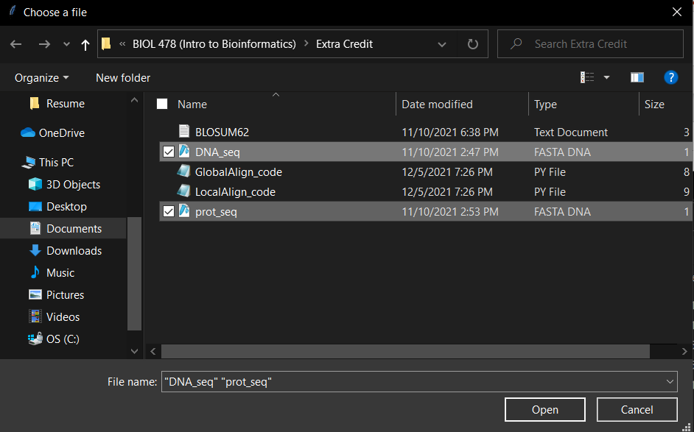
These two windows should pop up
Choose DNA_seq and prot_seq files and click open (Needs to be named DNA_seq and prot_seq exactly)
Make sure to exit the top window too for program to run

Slide 6
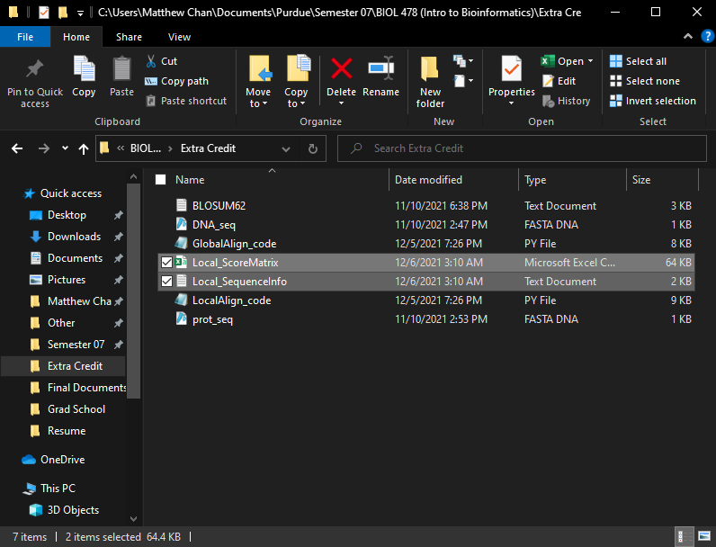
Two new files should appear in folder
Local_ScoreMatrix contains score matrix and traceback
Local_SequenceInfo contains alignment with other additional information

Slide 7
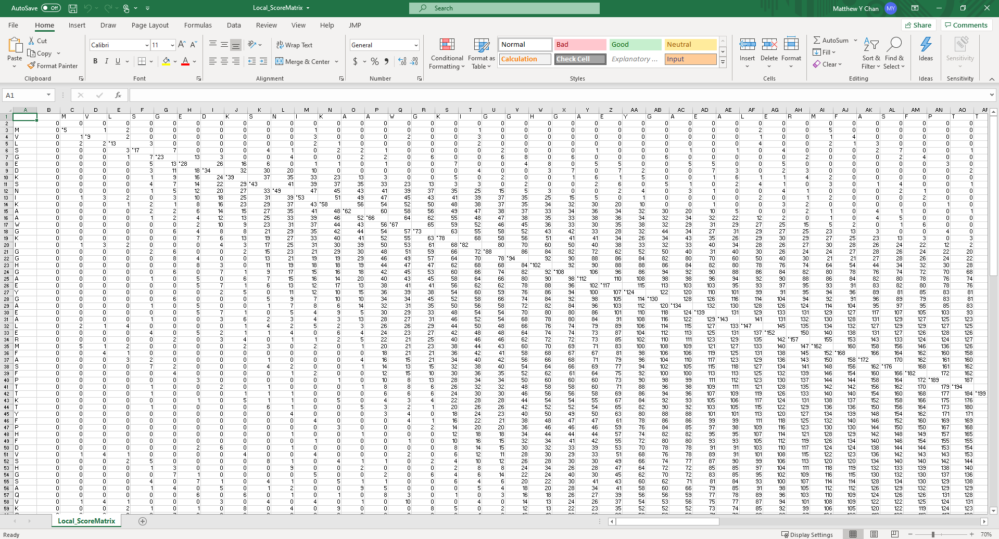
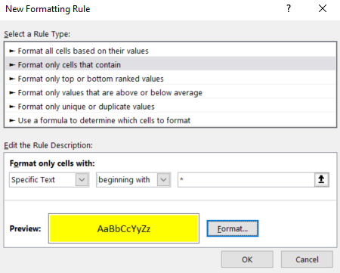
Excel with the score matrix
Traceback marked with *#
Therefore, ctrl+a; conditional formatting; Highlight cell rules; More rules; and making dialog something like the new formatting rule, you can highlight the traceback in the excel

Slide 8
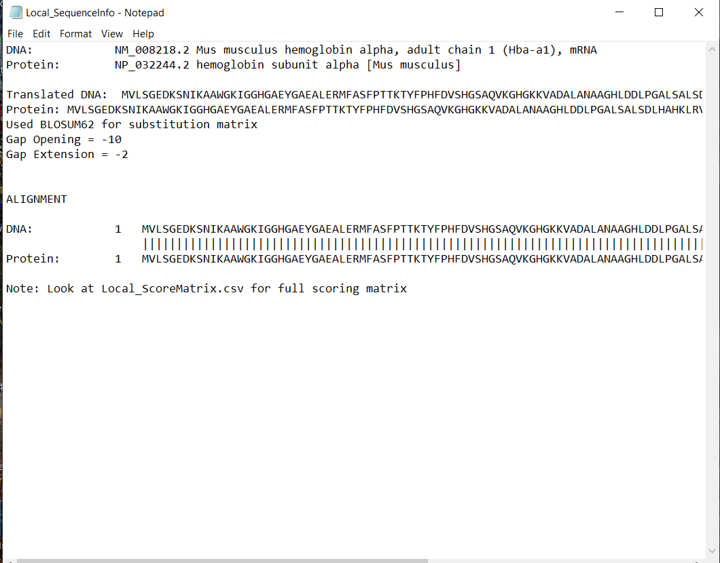
Contains fasta input names taken directly from fasta file
Has the translated protein from the DNA and protein sequence
Includes gap opening and extension values
Includes full alignment of translated protein and protein sequences
Note: it’s not that simple to change from BLOSUM62 to Pam, I just have it print BLOSUM62 was used

Slide 9
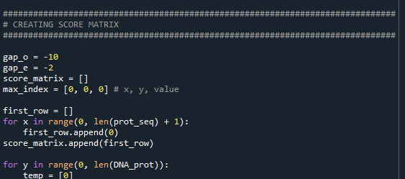
In this part of the code the gap opening (gap_o) and gap extension values (gap_e) can be changed
I don’t foresee anything else that may need to be changed, but if there is please email me and I’ll try to help you understand code. I didn’t comment it well at all.
Global Alignment runs exactly the same way with different logic. Files should start with global instead of local (sorry I’m not too great with comp sci and when I kept trying to get it all in one code it kept failing)

